Slide 1

Computer networking : THE SECURITY STANDARDS IN WIRELESS NETWORK AND TYPES ENCRYPTIONS

Slide 2
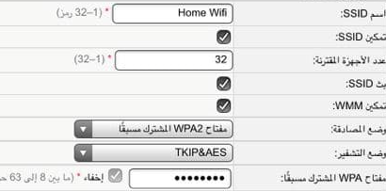
Introduction
Most of the users secure the wireless network with a strong password, but they overlook important points, but the most important of them are the type of encryption so that the wireless network is better protected from hackers

Slide 3

Types of encryption currently available
WEP (Wired Equivalent Privacy )
WPA (Wi-Fi Protected Access )
WPA2 (Wi-Fi Protected Access II )

Slide 4
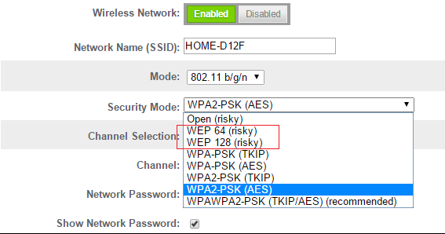
WEP (Wired Equivalent Privacy )
Despite revisions to the protocol and an increased key size, over time numerous security flaws were discovered in the WEP standard. As computing power increased, it became easier and easier to exploit those flaws.

Slide 5
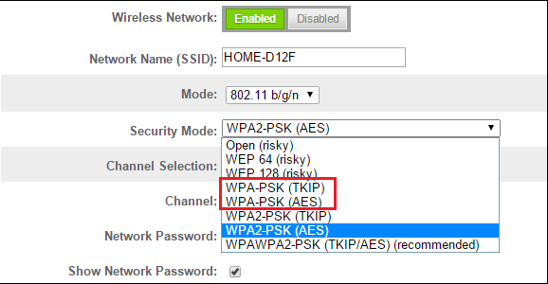
WPA (Wi-Fi Protected Access )
With this, many security flaws were resolved from WEP, which was officially approved in 2003
The most notable change is a message integrity check to determine whether attackers capture or alter the packets that move between the access point and the client.
But in the end it was also exploited

Slide 6
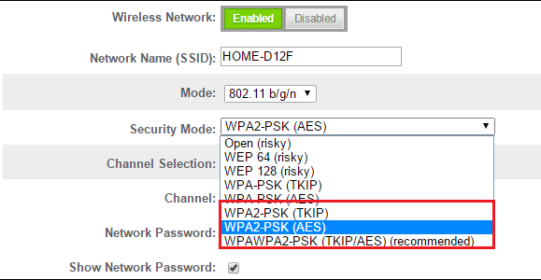
WPA2 (Wi-Fi Protected Access II )
WPA was replaced by a newer version in 2006, WPA2, one of the most important changes in it is that it uses AES algorithms and the introduction of CCMP as an alternative to TKIP
Currently, the vulnerabilities in the system are considered obscure, requiring the attacker to have access to the network in order to access the keys and then continuing the attack on other devices.
Unfortunately, the same vulnerability that is the largest hole in WPA Shield - the attack vector through Wi-Fi Protected Setup (WPS) - is still present in modern access points that support WPA2. Although hacking a WPA / WPA2 secured network using this vulnerability required 2 to 14 hours of continuous effort with a modern computer, it was still a legitimate security issue. WPS should be disabled, and if possible, the access point's firmware should be flashed to a distribution that does not support WPS until the attack vector is

